Slide 1
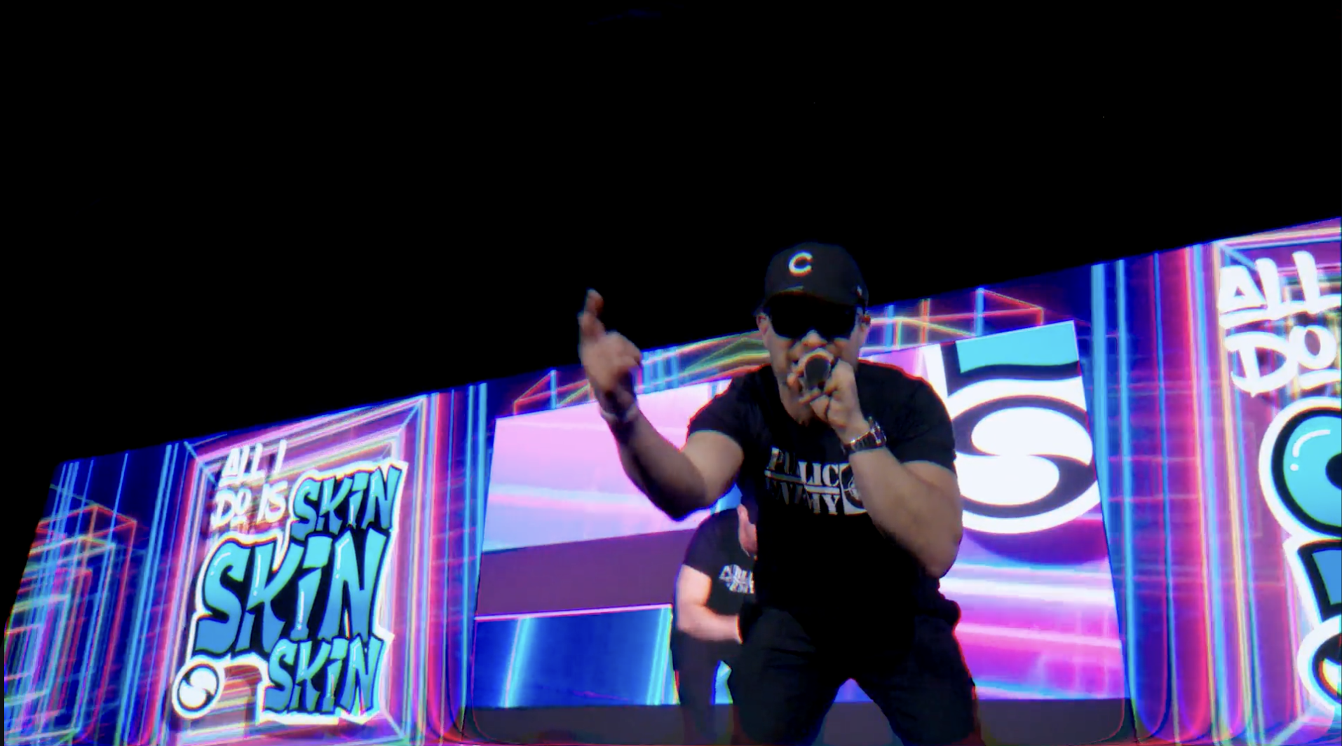

Creating an Experience to Generate FOMO with Sciton SkinCEO Boosted
©2025 Encore Global LP or its subsidiaries | 1

Slide 2
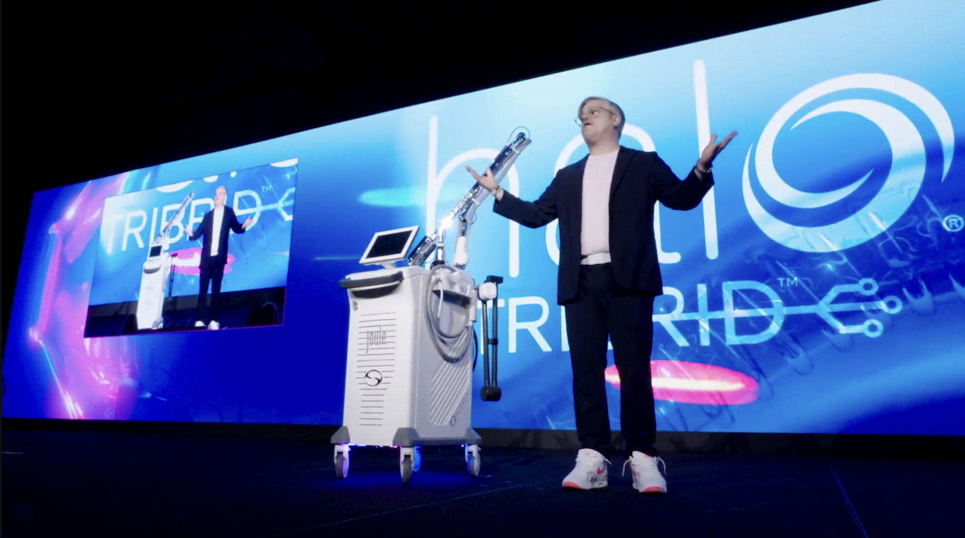


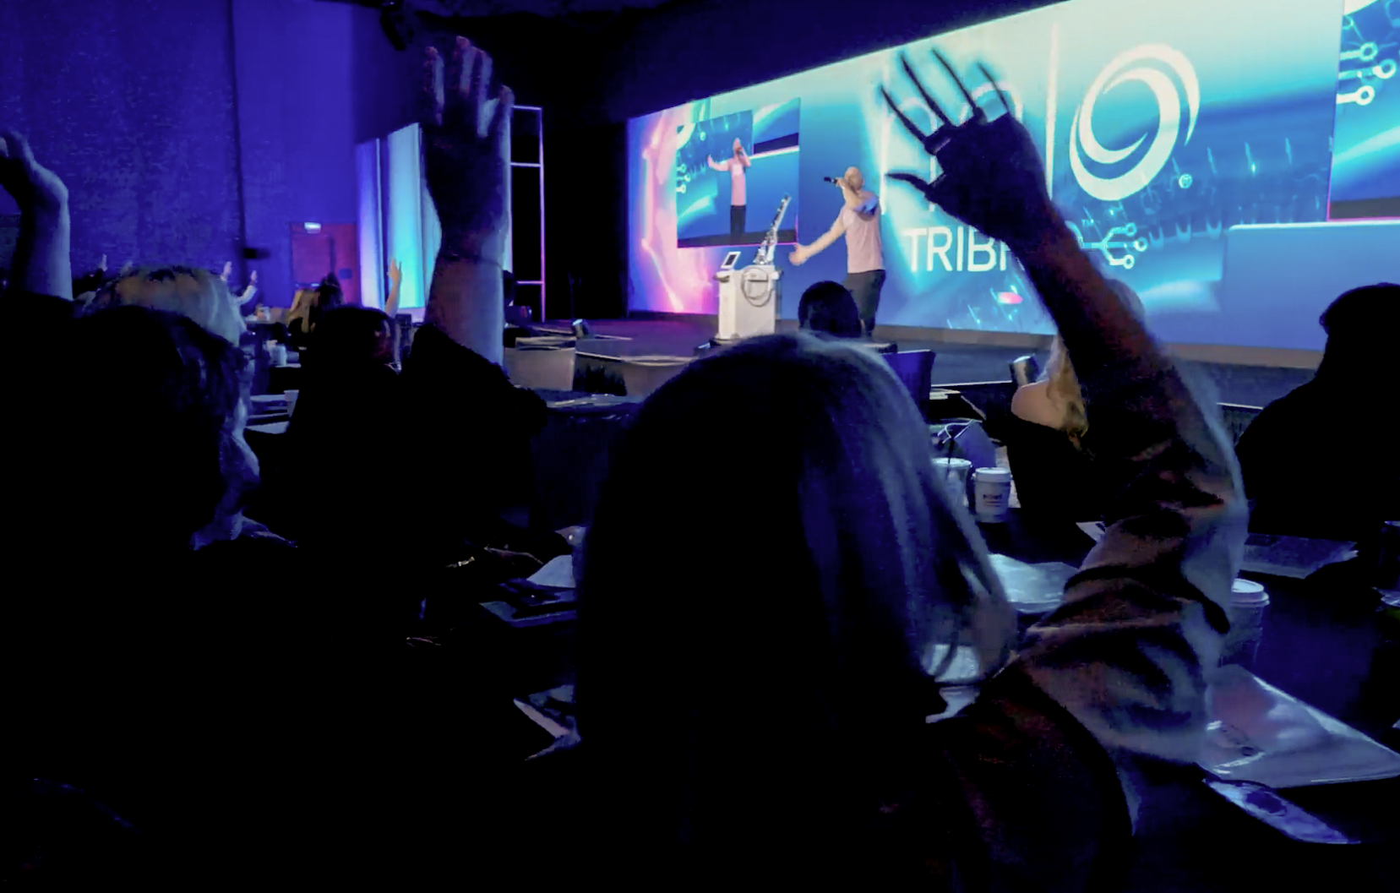
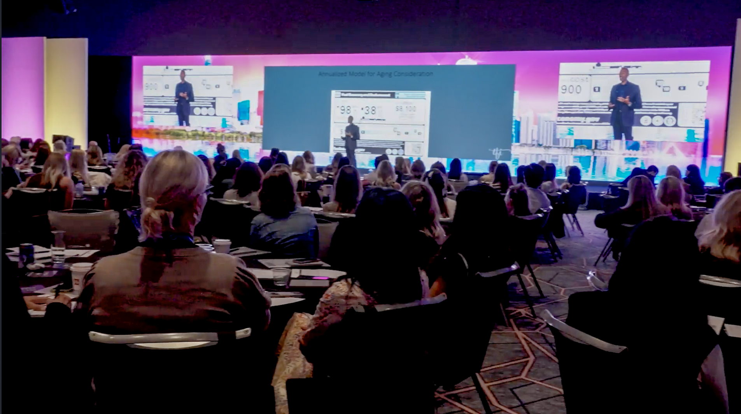

Creating an Experience to Generate FOMO with Sciton Skin CEO: Boosted
Trade Show
We were doing a lot of shows across the country and Encore was on almost all of them. The ones they weren’t on, the quality wasn’t the same.
Sam Coleman
Sciton Media Specialist
CHECK OUT THE CASE STUDY
OBJECTIVE
Sciton, a medical & aesthetic tech company, hosts annual roadshows with product demos and education for healthcare pros. This year, they aimed to create FOMO with an exclusive Skin CEO: Boosted event in Chicago for the HaloTribrid laser launch. Past shows' quality varied with different event partners, so Sciton sought a partner to ensure consistency, expertise and comprehensive solutions to make Skin CEO: Boosted a must-attend event.
SOLUTION
Encore was engaged as a strategic partner for all 9 roadshows. Registration support guaranteed a smooth arrival; the general session had a massive LED wall flanked by Backdrop Pro kits, an LED wall-animated DJ booth, scenic lighting, and engaging sound design, which heightened the energy. Static and video assets from our Creative Team transformed the entire session into an immersive experience, reinforcing buzz around the Halo Tribrid launch. Production and technology support elevated the product demos and continuing education sessions.
9 Show Series
Dallas, D.C., Boca Raton,
Orlando, Scottsdale,
Los Angeles, New York,
Nashville, and Chicago
SERVICES PROVIDED
Full-Service Event Production with an LED Wall
Animated Backgrounds, Hype Video & On-site Creative Direction
Audio & Lighting Equipment, Operation & Support
Rigging, Power & Internet
Recording Services
Demo Room Support
Registration Support
©2025 Encore Global LP or its subsidiaries | 2

