Slide 1
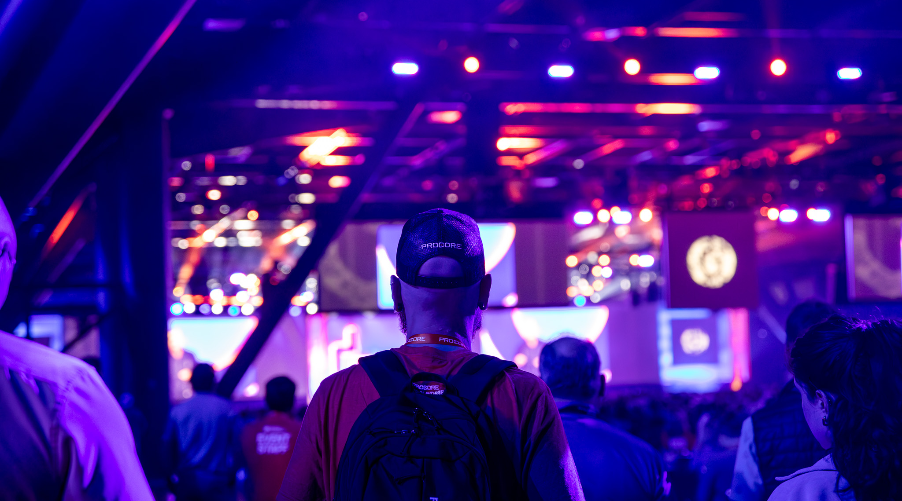

Event experiences to
connect a community
Procore Groundbreak 2025
CHECK OUT
THE VIDEO
George R. Brown Convention Center | Houston, TX

Slide 2
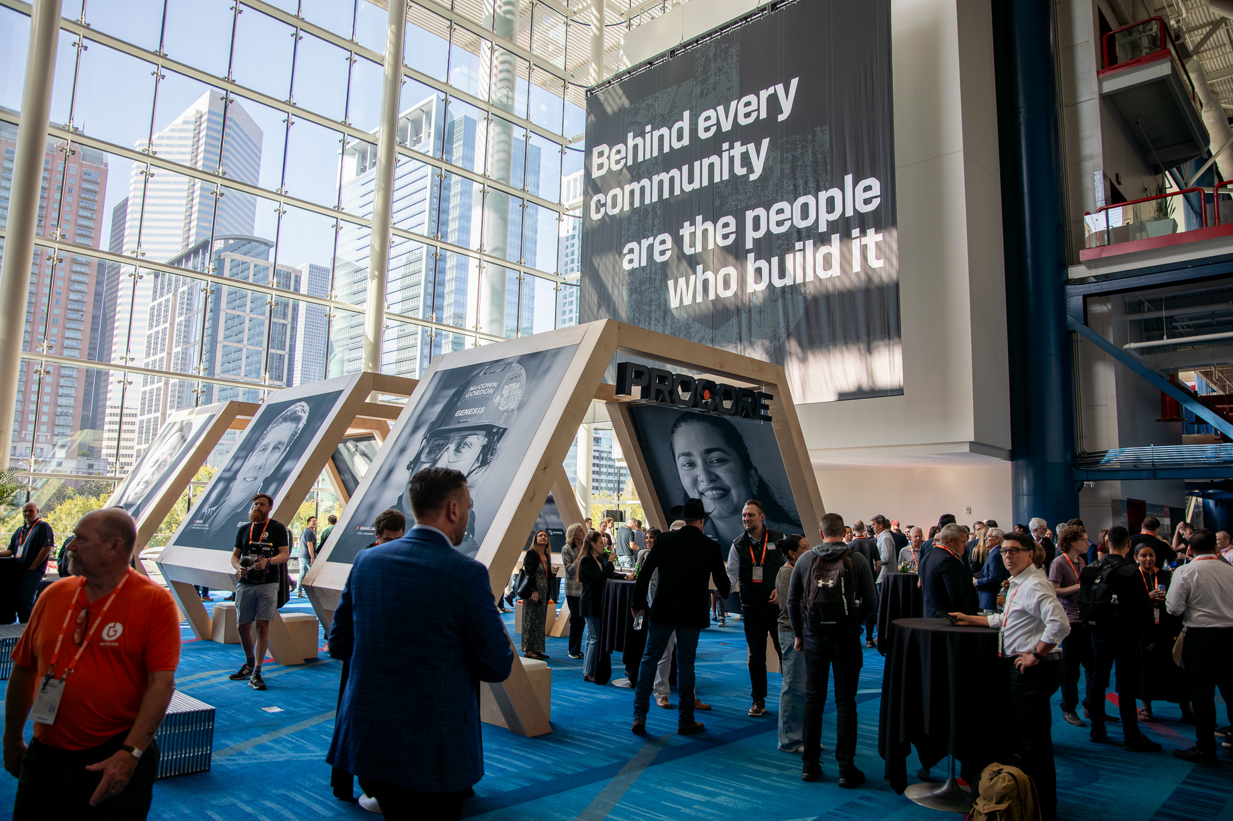
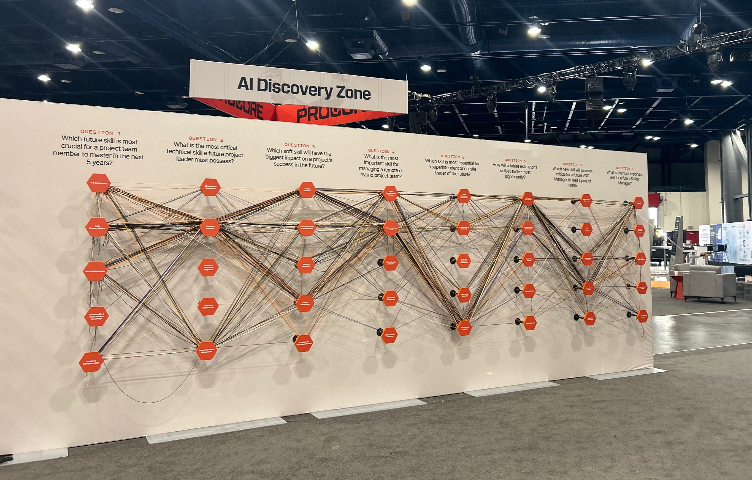
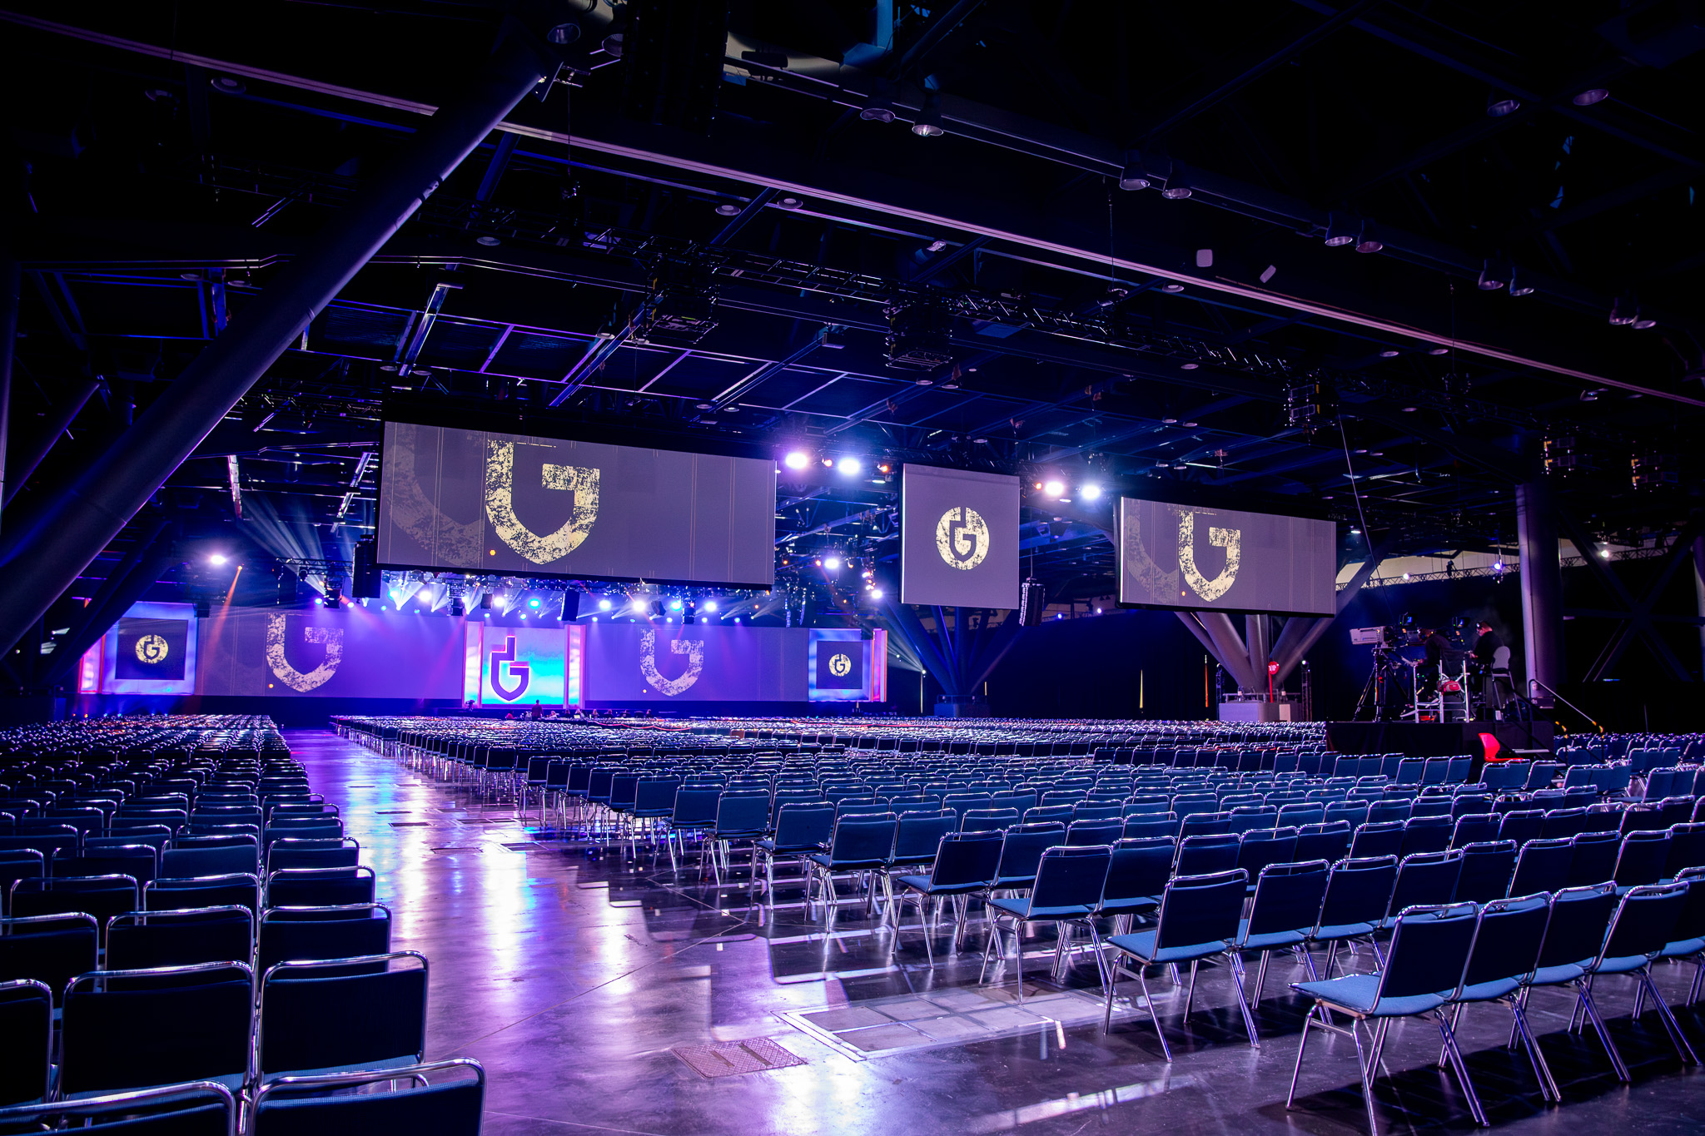
Procore Groundbreak 2025
This is our second year working with Encore and Hargrove on this event. And they're just a fantastic group of people, Wonderful to work with, but also just top of their game. What I love about working with Encore and Hargrove is that they're always helping us to step things up to the next level.
End-to-End Event Design & Production
What I love about working with Encore and Hargrove is that they're always helping us to step things up to the next level.
OBJECTIVE
Create a brand-led, story-rich environment for the construction tech community to forge meaningful connections, explore technology through interactive play, and embrace innovative ideas in a rapidly-changing industry.
SOLUTION
As their end-to-end solutions partner, Encore and Hargrove delivered a fully immersive experiential build that seamlessly translated the Procore’s brand language into a three-dimensional, real-world environment. The design featured custom scenic design, an engaging Helix Hub centerpiece, and a dynamic expo hall curated for social-worthy moments and meaningful touchpoints.
Every aspect of the attendee journey was thoughtfully branded, from photo opportunities and tactile activations to environmental graphics that reinforced a holistic experience. This space was designed to speak the brand’s identity, foster opportunities for hands-on engagement, and create a unified environment that felt both cohesive and intentional.
Kimberly Hastings
Director of Global Brand Events
Procore
5.4K+
Attendees
FROM ATTENDEES
“My favorite thing about this has been the bonds that I've been able to make”
“It's been a great experience and looking forward to next year!”
SERVICES PROVIDED
Event Strategy
Creative & Design
Fabrication & Graphics
Exhibitor Services Management
Event Management
General Contracting
End-to-End Production
Media Management
A/V Equipment & Installation
Live Show Production
Stage Management
Custom Content Creation
CHECK OUT THE VIDEO

