Slide 1


Olympus Shares Innovation and Vision at National Sales Meeting

Slide 2
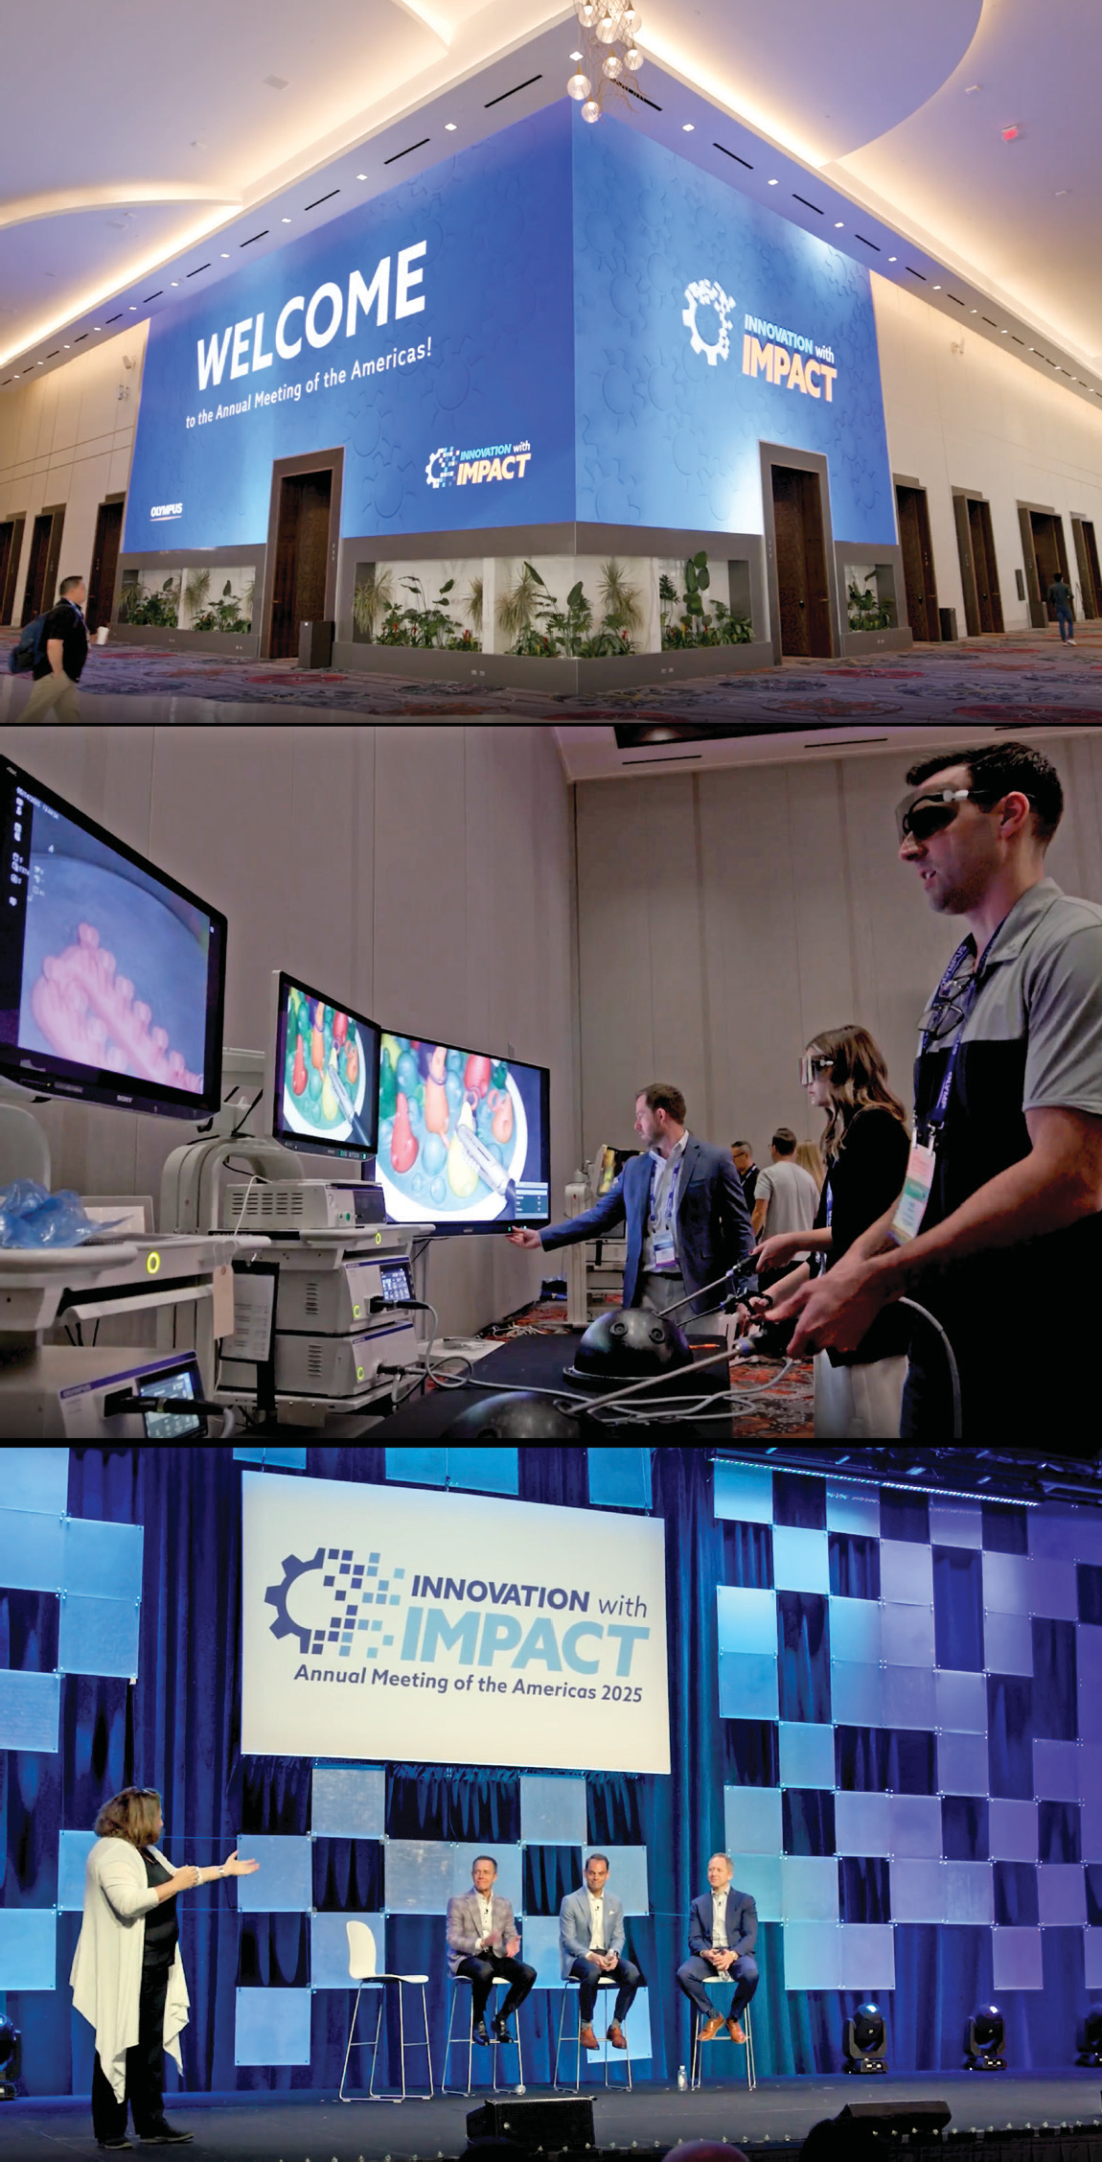







Olympus Shares Innovation and
Vision at National Sales Meeting
From an event planner perspective, I need someone that is going to be a true partner with us...I feel that when I don’t need to worry about something, that is a huge piece of success of the meeting, so I want to thank Encore for all their help.
CHECK OUT THE CASE STUDY
Objective
The Olympus National Sales Meeting welcomed over 3,000 Olympus employees from 12 sales divisions across the country to the Caesars Forum in Las Vegas, Nevada. Each year, the sales teams, who sell medical device solutions for disease prevention and treatment, gather to kick off next year’s fiscal plan, celebrate the team’s wins from the previous year and receive on-site product training and real-time product demonstrations.
Solution
Encore designed, produced and executed the event with our end-to-end production team. We created an educational, cohesive space that resonated emotionally and brought meaningful opportunities to learn and connect. The Encore and Olympus teams strategically collaborated to produce a smooth general session, 12 mini general
sessions, 12 award dinners, 40+ breakout sessions, and numerous product activations in partnership with Sony. With 13 stage managers, 3 project managers and 5 producers on- site, we provided true partnership with an “all-hands-on-deck” approach to coordination and event execution. The result: the successful delivery of a unified, celebratory event that showcased the company’s innovative products and invigorated the team for the future.
Services Provided:
Bekki Morgan
Senior Director of Events, Olympus
13
stage managers
3
Full-Service Event Production
Rigging Services
Project Management
Full Power & Internet
Audio & Video Equipment, Operation & Support
Digital Services
project managers
5
producers on-site
©2025 Encore LLC or its Subsidiaries. All Rights Reserved.

