Slide 1
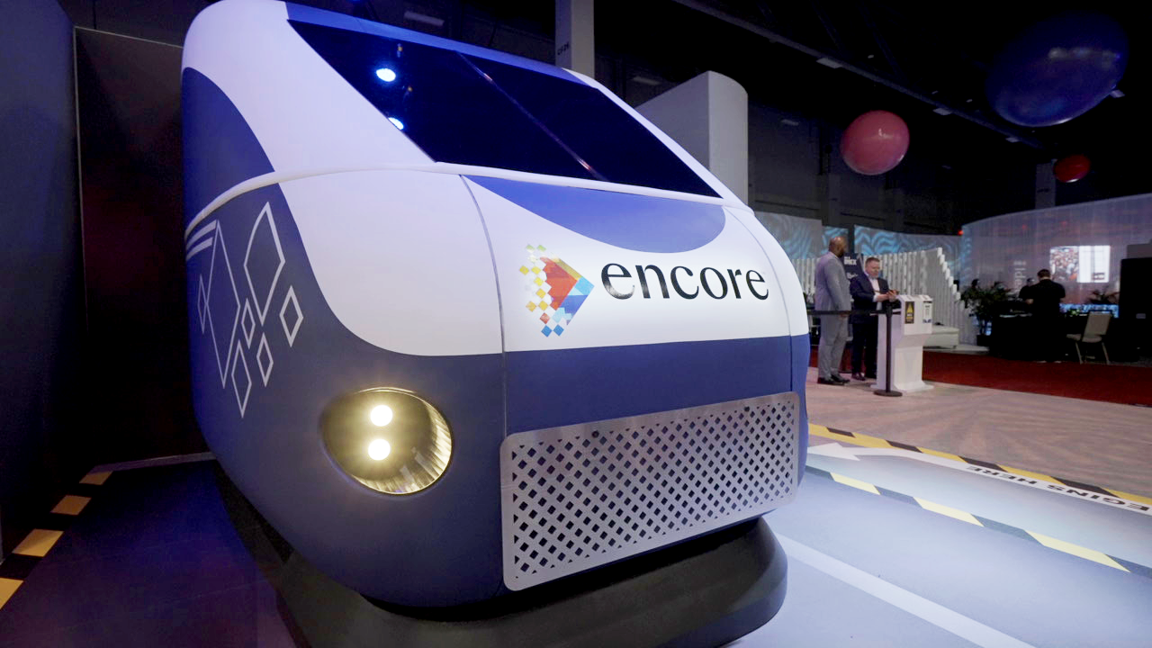
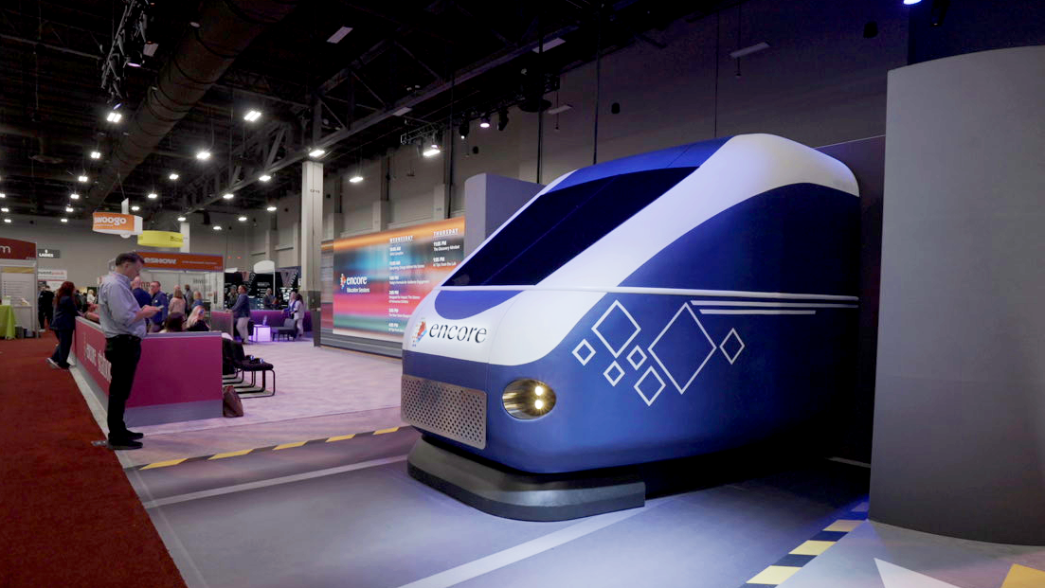

Reimagining Engagement at IMEX America 2025
©2025 Encore Global LP or its subsidiaries | 1

Slide 2
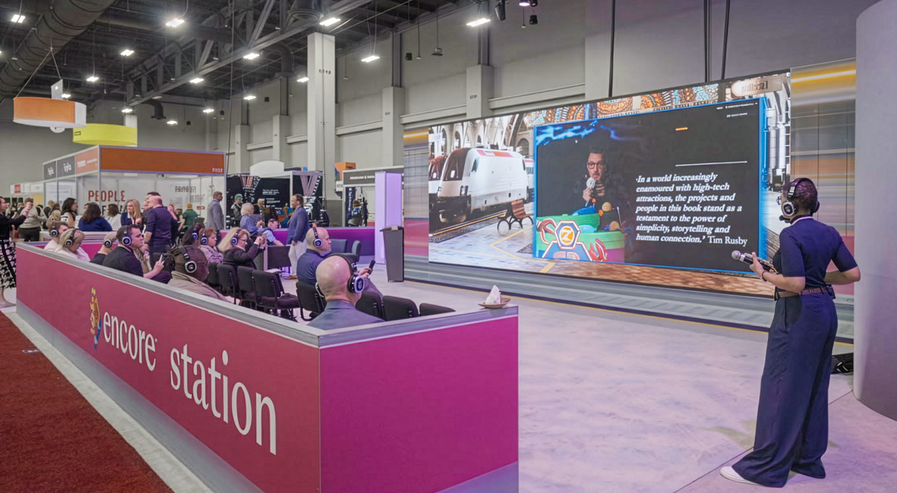


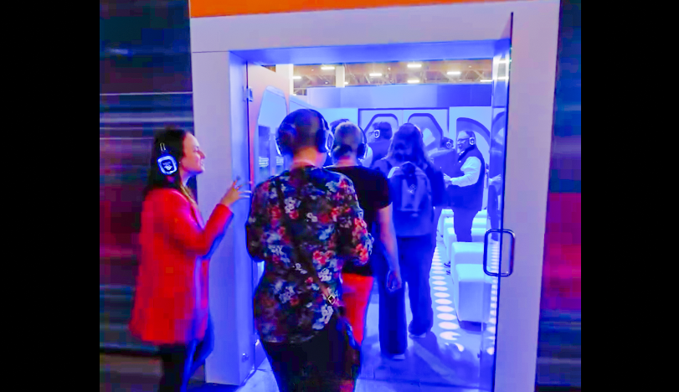

Reimaging Engagement: IMEX America '25
Trade Show
This was unlike any other experience I’ve seen at any other booth here.
You have that human real-life touch with technology and bringing that together, they make a really amazing experience. Encore might be one of my favorite booths.
CHECK OUT THE CASE STUDY
OBJECTIVE
IMEX America 2025, the largest global business event trade show in the industry, welcomed meeting, event and travel professionals to Las Vegas, Nevada. As an official IMEX partner for the 4th year in a row, Encore sought to create an interactive exhibit to serve as a guiding hub of inspiration and education for event planners. Our presence positioned us to meet and reconnect with our customers, associates and industry contacts.
SOLUTION
We imagined, designed and built the Encore Station, where we led event participants on the Journey of Discovery. Our immersive, simulated train ride, executed with our full-service production capabilities, offered a wealth of bold ideas to boost planner creativity. After the journey, participants found more opportunities for ideation at our Inspiration Hub. On the IMEX floor, Encore engaged and inspired participants, serving as a source of innovation and acting as a catalyst for transformative experiences that make an impact. Most importantly, we ignited the spark of exciting ideas to help planners generate impact at future events, established professional connections, and forged
new partnerships.
Emily Munsick
IMEX America 2025 Attendee
5,000
900+
sq. ft. activation
participant visits
SERVICES PROVIDED
17
Full-Service Production
Theme & Branding
Creative Content Development
Design & Fabrication
Full Power & Internet
Event Technology Operation & Support
Digital & AI Services
Rigging Services
Project Management
45%
educational
sessions
Increase in on-site partnership meetings
©2025 Encore Global LP or its subsidiaries | 2

