Slide 1
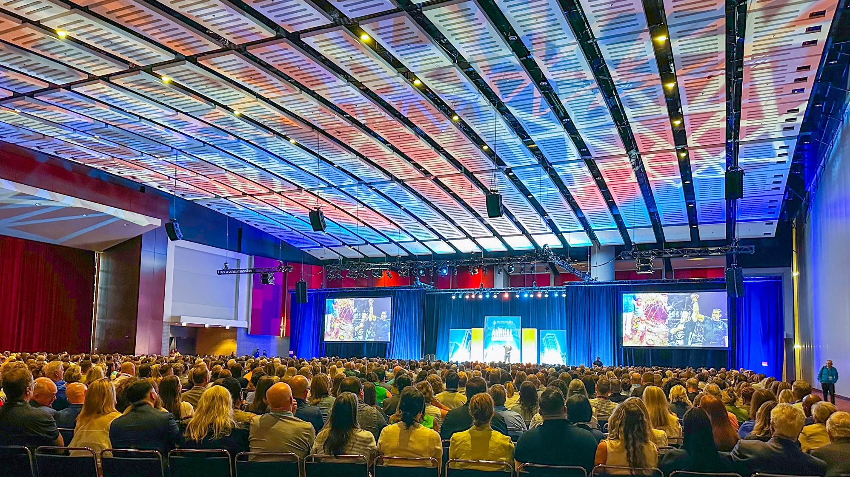

Destinations International
Conference Ignites Community Passion for Travel
©2025 Encore Global LP or its subsidiaries | 1

Slide 2
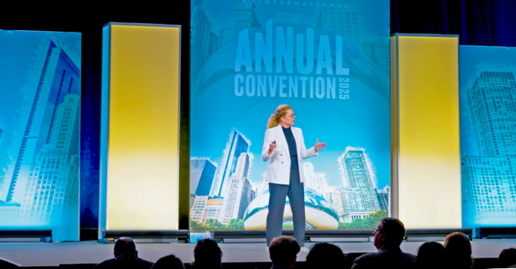

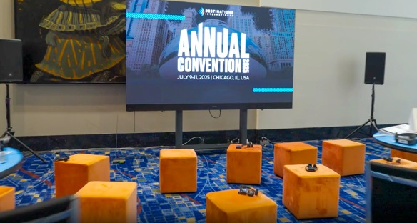

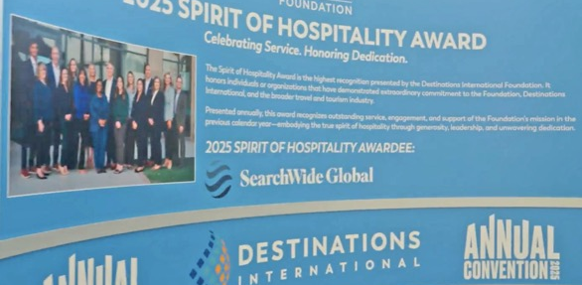

Destinations International Conference Ignites Community Passion for Travel
Association, Convention Center
We know that when we’re working with Encore, whether it’s a meeting for a hundred people in a hotel or whether it’s a couple thousand, the quality and the expertise will be there.
OBJECTIVE
Destinations International, the association of destination management organizations (DMOs), invited convention and visitor bureau leaders to their annual meeting. Over 2,100 participants from 28 countries gathered in Chicago, Illinois to discuss trends, attend education sessions, ideate together and collaborate. Members also enjoyed opportunities to share their collective passion for their work and foster community within the greater network of DMOs.
SOLUTION
As their ongoing full-service partner, Encore was entrusted to meet DI’s growing needs. We produced the entire conference, which included a general session, mini general sessions, pre-event sessions, certification and education seminars and networking events. Utilizing event technology that delivered big impact, our dynamic lighting design, Backdrop Pro and live-feed social media digital billboard each made an impression while respecting the budget. As the event general contractor, Hargrove from Encore supported the vision with custom fabricated scenic elements, including a “wavy” informational wall, a branded photo op installation and more. As a result, the event saw its highest attendance to date. Participants were engaged and harmoniously connected, with an openness to learn with — and from — their peers and competitors.
Don Welsh
Chief Executive Officer
Destinations International
When I’m able to trust someone to do their job, it makes my job easier... working with Encore
has been great.
SERVICES PROVIDED
Full-Service Event Production
Project Management
Power & Internet
Event Technology
Operation & Support
General Services Contractor
Fabrication Services
Andrea Lane Crawley
Senior Manager of Meetings and Events
Destinations International
Check out the Case Study
©2025 Encore Global LP or its subsidiaries | 2

