Slide 1
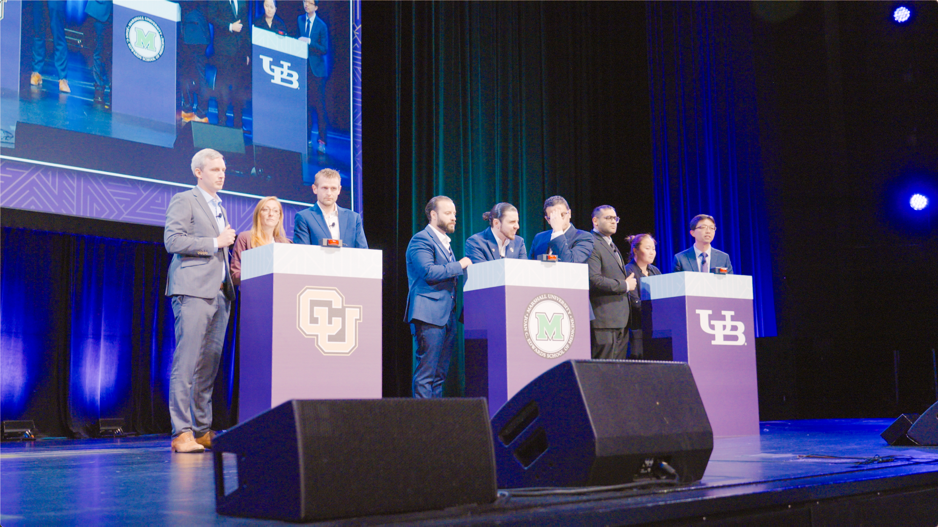

CHEST Celebrates 90 Years of Innovative Learning
©2026 Encore Global LP or its subsidiaries

Slide 2
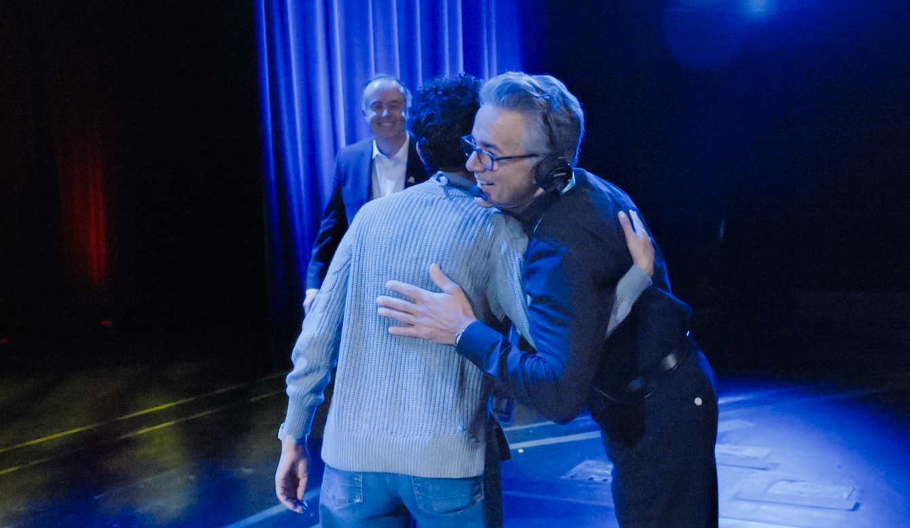

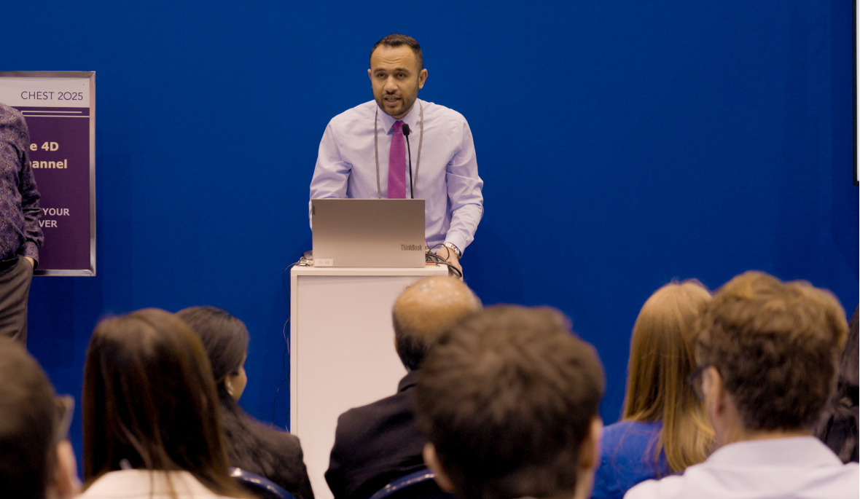
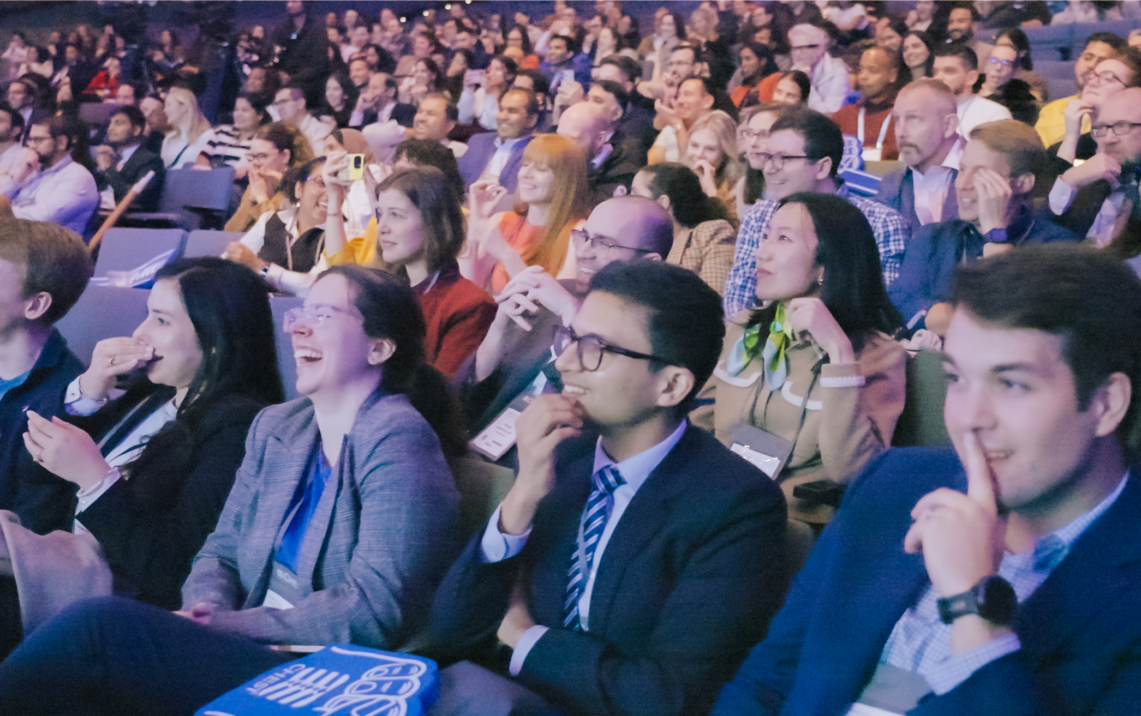
90 Years of Innovative Learning
Association, Convention Center
CHECK OUT THE CASE STUDY
[With Encore], you’re working with a partner that is a true partner, not just a vendor.
OBJECTIVE
The CHEST 2025 annual meeting at McCormick Place in Chicago marked its 90th anniversary with a milestone celebration of progress in pulmonary, critical care and sleep medicine. With a focus on innovation and continuing education, the meeting brought together fellows, residents, physicians and other participants.
Jody Egel
Sr. Director, Meetings & Education
CHEST
SOLUTION
Partners for 10+ years, Encore delivered a full suite of event technology and production services for the general session space, breakouts, silent theater sessions, overflow rooms, simulation centers and exhibit hall. A flexible-use stage was designed for the opening general session and ‘CHEST Challenge’ game show, tailoring scenic, technology and content solutions to each session. The game show experience was energized with broadcast-level production and real-time participant response technology, spotlighting contestants from top medical schools. On the expo floor, silent theater sessions with personal headsets and multi-channel capability allowed participants to move freely between sessions, saving time and minimizing distractions from external noise. The result: dynamic event technology support for session content, improved session access on the expo floor and memorable moments to connect with peers.
10+
2500+
years of
partnership
participants
39
16
SERVICES PROVIDED
General Session Production
Silent Theater Sessions
Project Management
Digital Services
Audience Engagement Solutions
Event Technology
Presentation Management
Overflow Room Management
breakout
sessions
silent theater sessions

