Slide 1
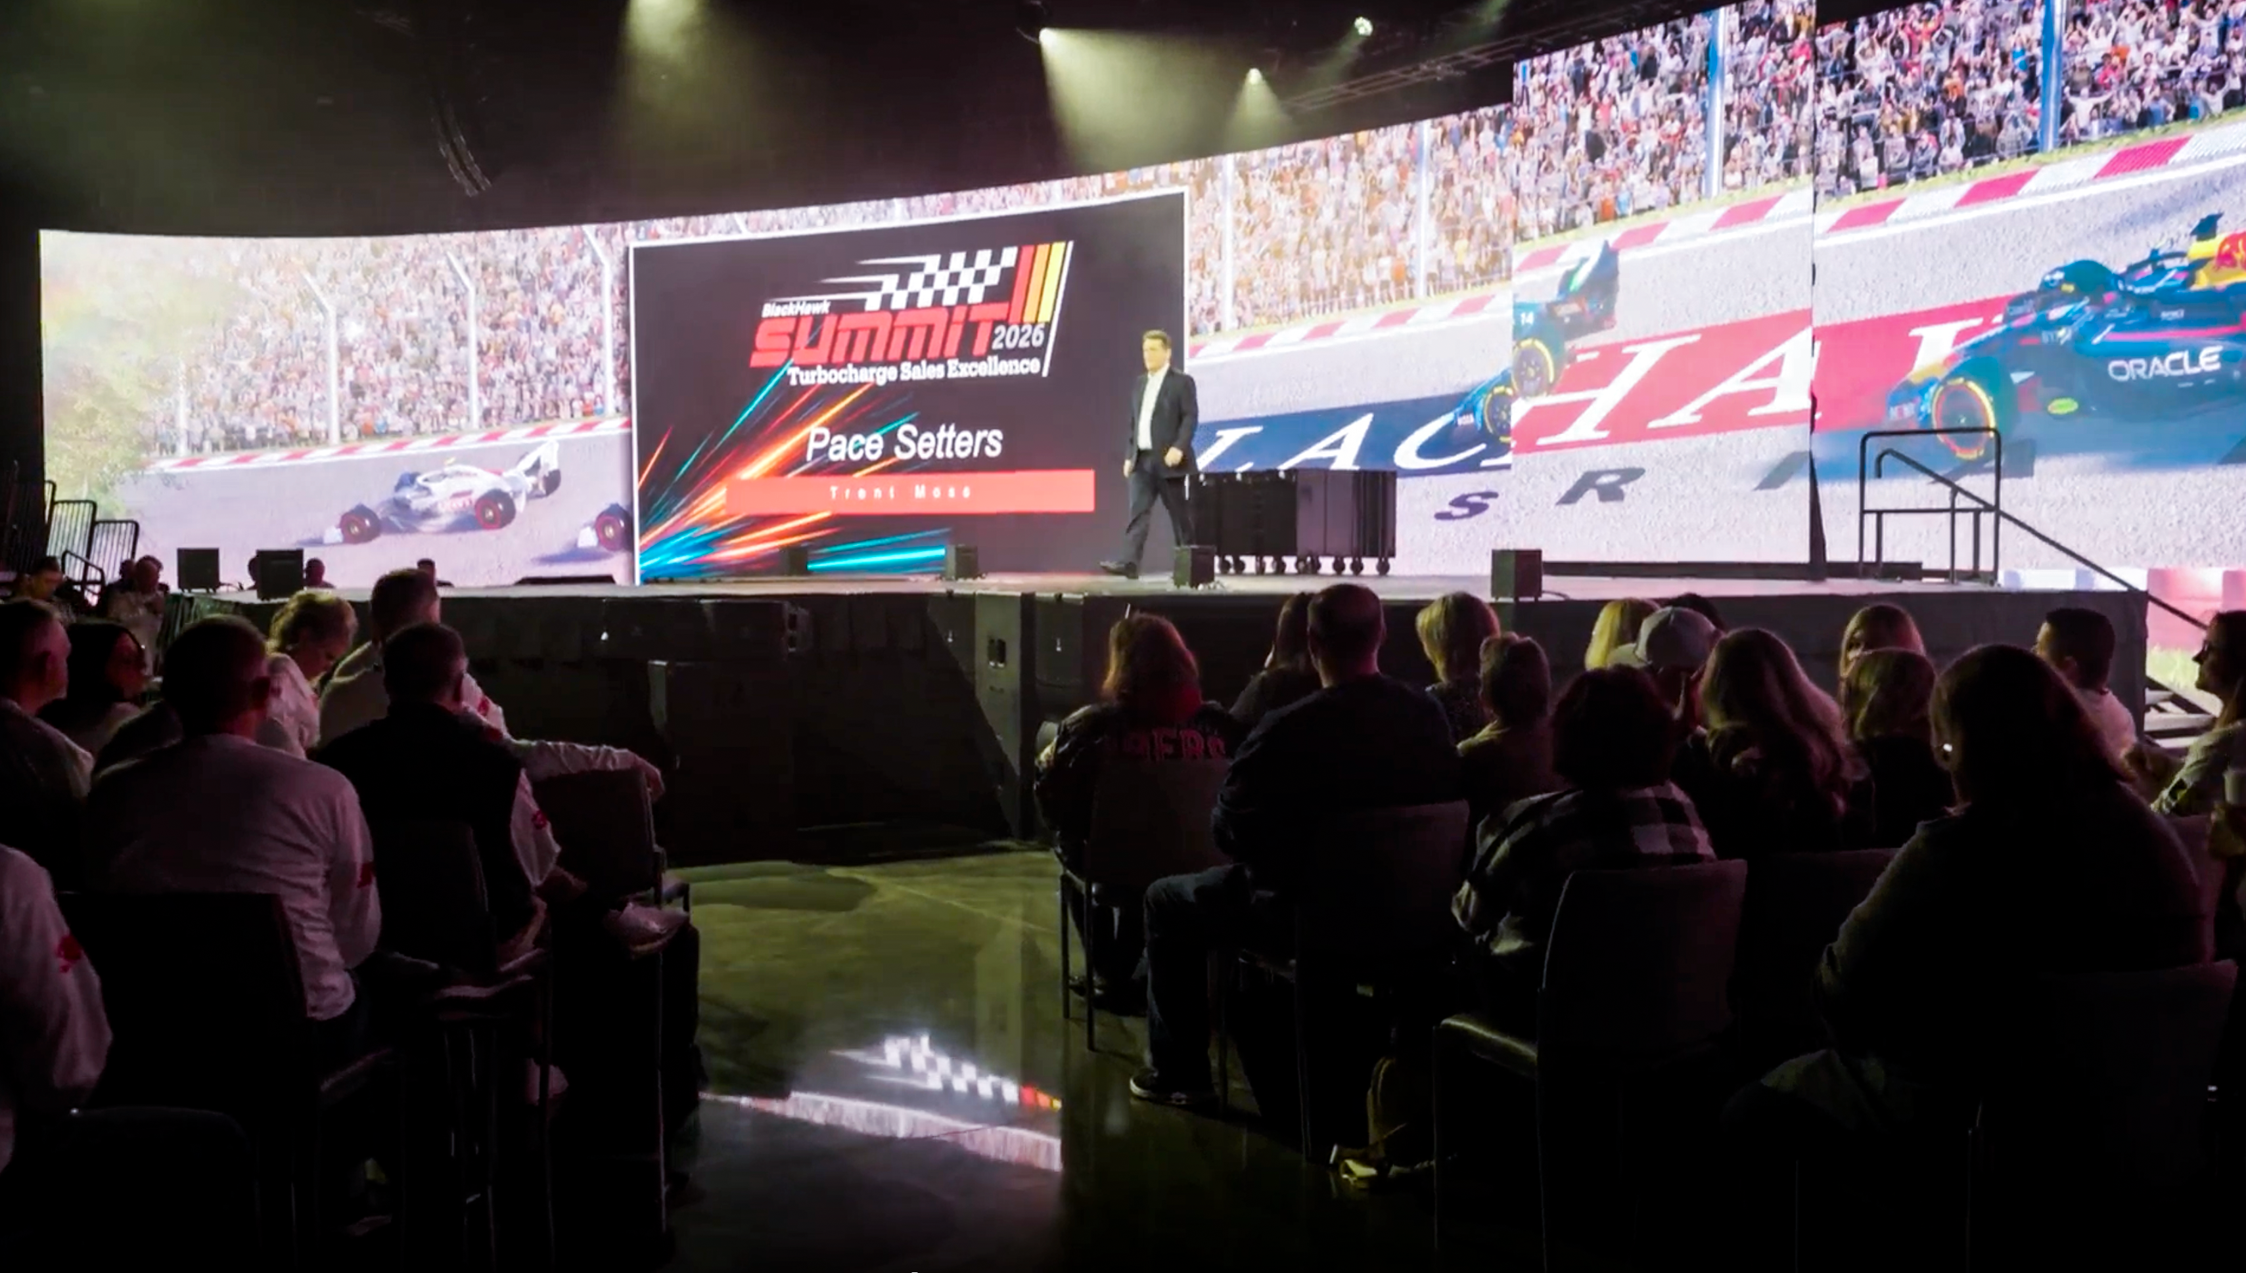

BlackHawk Industrial Energizes Summit with Turbocharged Experience
©2026 Encore Global LP or its subsidiaries

Slide 2
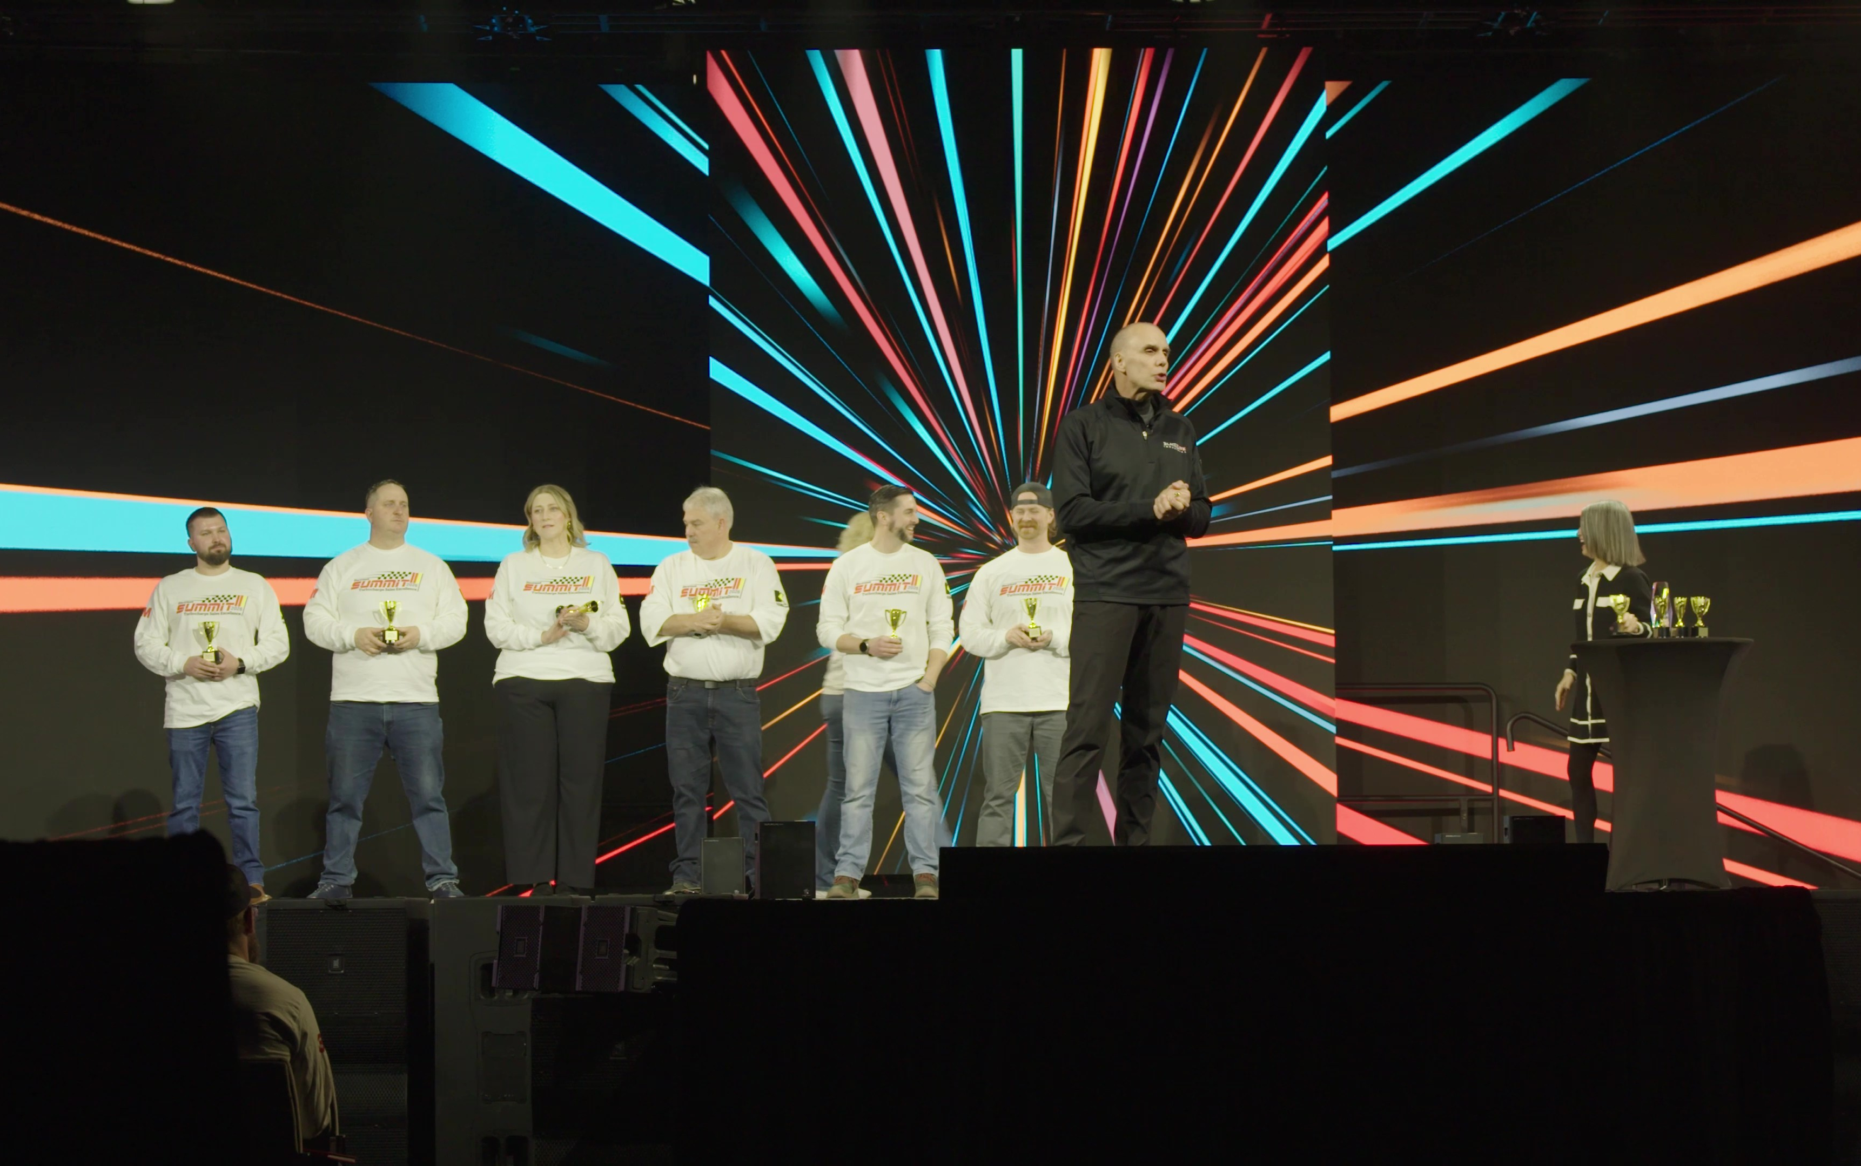

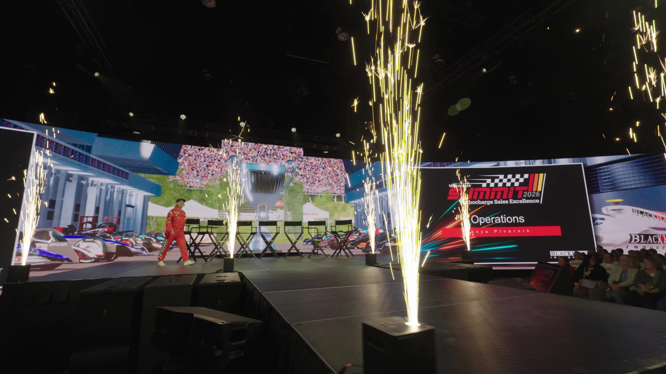
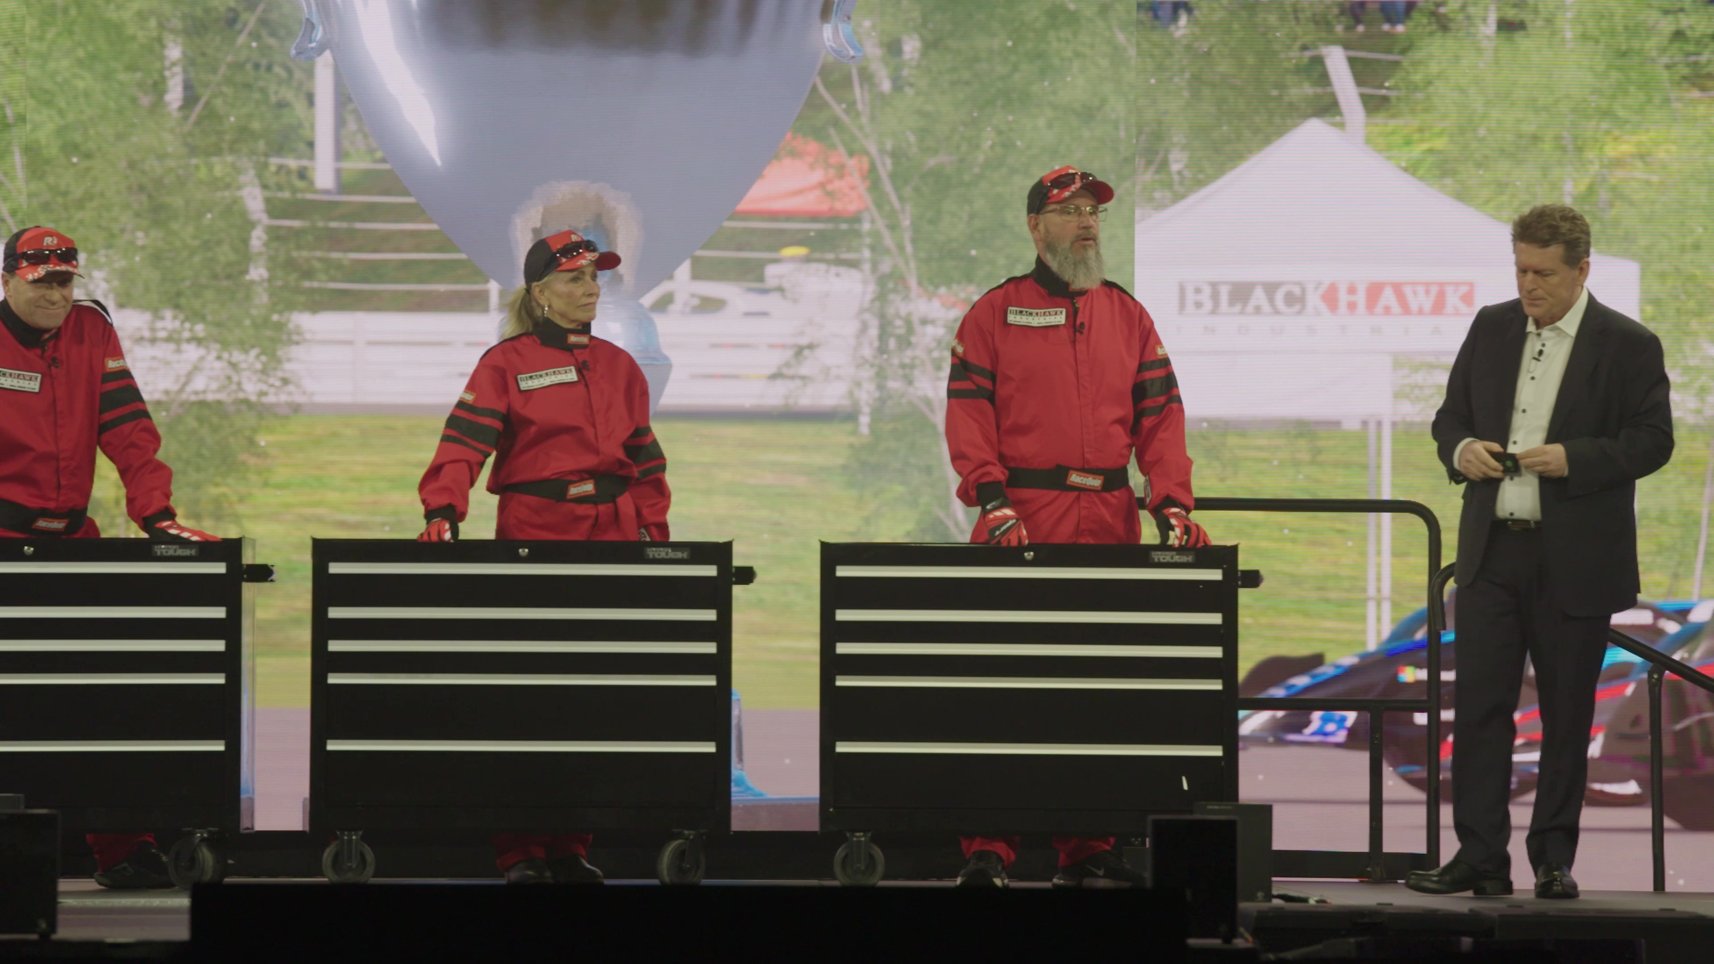
Turbocharged Summit Experience
Full-service Production, Convention Center
[Encore has] been able to work with us, work within our budget, and make some recommendations on what we can do better...I am absolutely delighted in the outcome.
CHECK OUT THE CASE STUDY
OBJECTIVE
The BlackHawk Industrial Summit at the Oklahoma City Convention Center gathered team members and customers for an energizing, sales-focused experience. The three-day event offered 500+ participants the opportunity to gather insights on sales excellence, make professional connections and forge new business deals.
SOLUTION
Laurie Janu
Director of Marketing
BlackHawk Industrial
BlackHawk sought to rev up their participants by scaling their production value with Encore after a supportive event technology experience for a previous event. To bring their Formula 1 theme to life, high-octane, racing-themed videos and motion graphic backgrounds and transitions created an exciting atmosphere and experience. The custom-hung, curved 120 ft. LED wall built for the conference, coupled with surround sound, immersed and entertained participants. The run of show was kept simple and smooth by our on-site show management team, so the BlackHawk team could stay focused.
The result: An engaging production supported successful customer relationships, impressed stakeholders and supported BlackHawk’s business goals.
The experience is on another level. The visuals, the special effects, the sound — all of it has been tremendous for us.
SERVICES PROVIDED
Production Support
Project Management
Stage Management
Creative Services
Event Technology
Rigging
John Mark
President and CEO
BlackHawk Industrial

